Slide 1
Angular Component Trees
Peter Eijgermans peter.eijgermans@ordina.nl

Slide 2
Angular-app: Tree of components
<todo-app>
<todos-list>
<todo-item>
<todo-item>
{{ todo-text}}
{{ todo-text}}
{{ todo-checked}}
{{ todo-checked}}

Slide 3
Application as a tree of components
Meerdere components?
Separaat Child Component ontwikkelen
Definieren in de app.module.ts
Via HTML insluiten in de parent-component
Herhaal deze stappen voor alle benodigde componenten

Slide 4
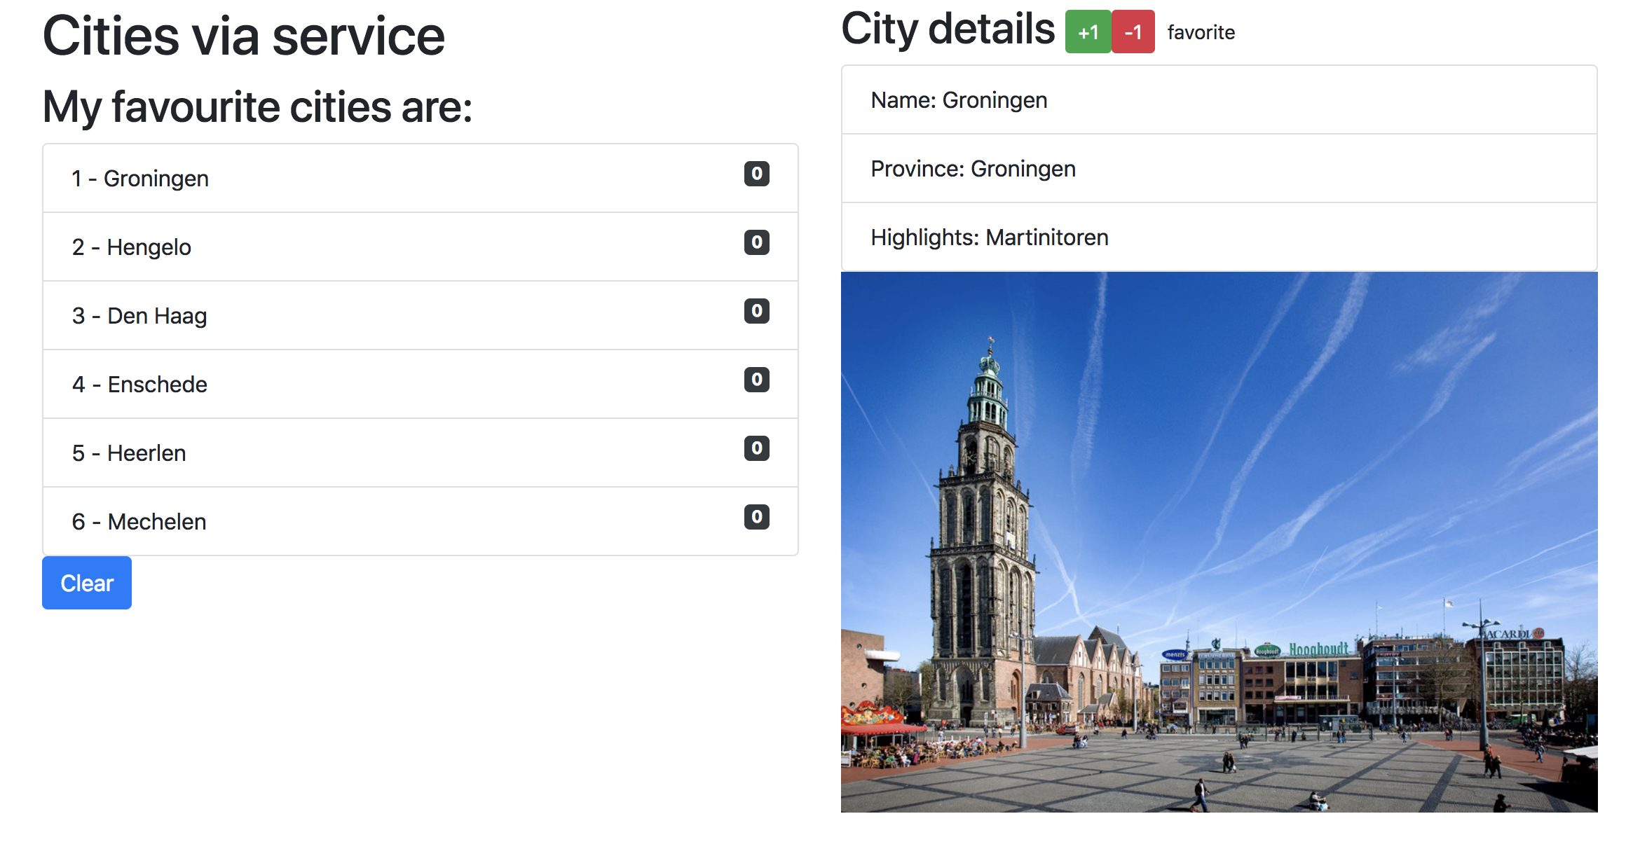

Slide 5
Component based
SideBarComponent
AppModule
AppComponent
CityListComponent
CityDetailComponent
Notes:
Angular apps are composed of modules.
Modules exports classes, function, values — that other modules import.

Slide 6
Component based A component adds logic to DOM elements Angular app consist of a treestructuur of components
main.ts
AppModule
AppComponent
app.component.html
CityListComponent
CityDetailComponent
city-detail.component.html
Notes:
Angular is a tree of components, because it has the same structure as your html-structure !!!
Index.html is the parent template of AppComponent ect…
AppComponent is the parent of BookComponent and …
main.ts

Slide 7
1. Detailcomponent maken
// city.detail.ts
import { Component } from '@angular/core';
@Component({
selector: 'city‐detail', template: `
<h2>City details</h2>
<ul class="list‐group">
Nieuwe selector
Nog in te vullen
<li class="list‐group‐item">Naam: [naam van stad]</li>
<li class="list‐group‐item">Provincie: [provincie]</li>
<li class="list‐group‐item">Highlights: [highlights]</li>
</ul>
`
})
export class CityDetail{
}

Slide 8
2. Insluiten in Module
// app.module.ts
…
import {CityDetail} from "./city.detail"; // Nieuwe component invoegen
@ngModule({
…
declarations: […,CityDetail]
})
// Niet vergeten: invoegen bij declarations!
export class AppModule {
…
}

Slide 9
3. Insluiten in HTML
<!‐‐ app.html ‐‐>
<div class="row">
…
<div class="col‐md‐6">
…
<city‐detail></city‐detail>
</div>
</div>
Combineren met overige HTML

Slide 10
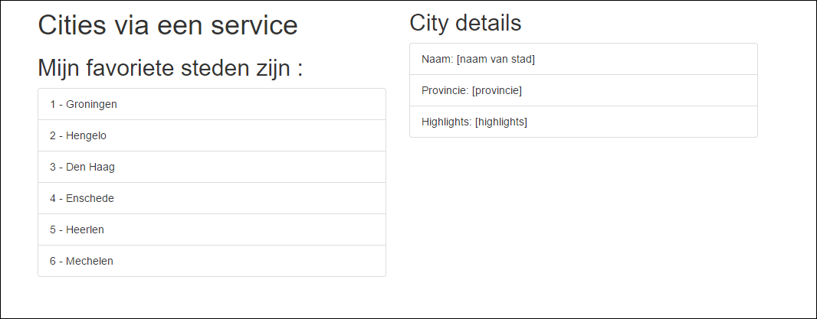
4. Resultaat
Nog in te vullen
Doel: details van geselecteerde city tonen in child-component

Slide 11
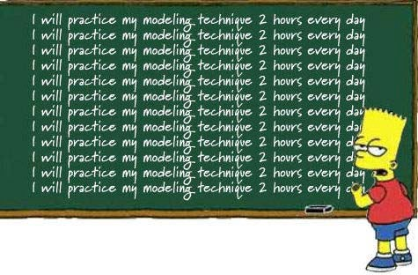
Checkpoint
Componenten kunnen binnen componenten worden opgenomen
Breidt de HTML van de Parent Component uit met declaratie van de Child Component
Denk er aan Child Component te importeren in de @ngModule
Opdracht: 6a + 6b
Oefening….

Slide 12
Data flow tussen componenten
Werken met inputs en outputs

Slide 13
Data flow tussen components
“Data flows in to a component via
@Input() ‘s”
Data flows out of a component via
@Output()’s”

Slide 14
Parent-Child flow: de annotatie @Input()
<city-app>
[city]=“currentCity”
…
@Input() city: City
<city-detail>
{{ city.name}}
{{ city.province}}

Slide 15
Werken met @Input() in ChildComponent
Service Input importeren in de betreffende component
Annotatie @Input() gebruiken in de class definition
// city.detail.ts
import { Component, Input } from '@angular/core'; import { City } from "./city.model";
@Component({
…
})
Input
export class CityDetailComponent {
@Input() city: City;
}

Slide 16
Parent Component aanpassen voor @Input
<!‐‐ app.html ‐‐>
<div class="row">
<div class="col‐md‐6">
…
<ul class="list‐group">
<li *ngFor="let city of cities" class="list‐group‐item" (click)="getCity(city)">
{{ city.id}} ‐ {{ city.name }}
</li>
</ul>
</div>
<div *ngIf="currentCity">
<city‐detail [city]="currentCity"></city‐detail>
</div>
</div>
</div>
Aanpassing
Aanpassing!

Slide 17
Parent Component Class uitbreiden
export class AppComponent {
// Properties voor de component/class
public cities:City[];
public currentCity:City;
… getCity(city) {
this.currentCity = city;
}
…
}

Slide 18
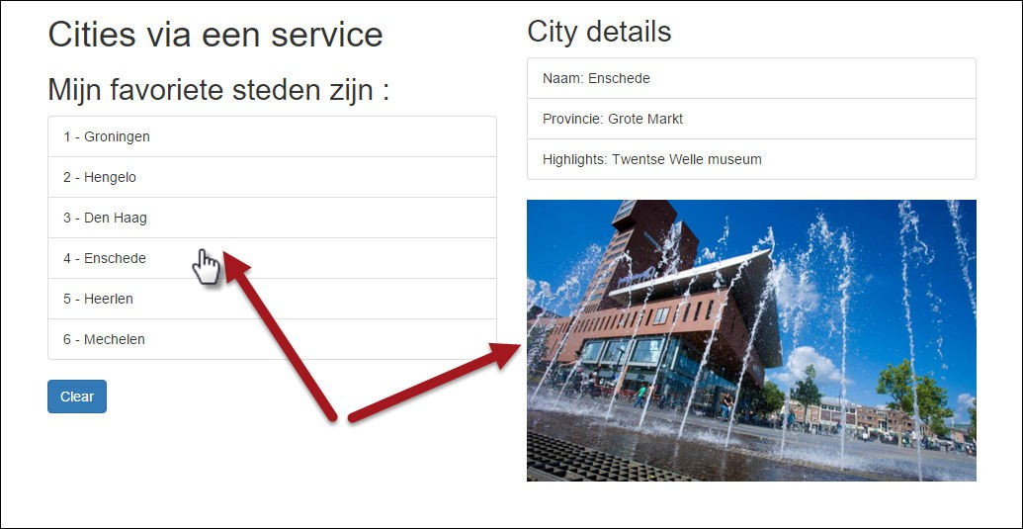
Resultaat

Slide 19
Checkpoint
Data flow naar Child Component : werken met @Input() en
[propName]=“data”
Opdracht: 6c
Oefening….

Slide 20
Child-Parent flow: de annotatie @Output()
<city-app>
(event)=“myEvent($event)”
…
@Output() event: EventEmitter<Type>
<city-detail>
{{ city.name}}
{{ city.province}}
P.165

Slide 22
Child-Parent flow: de annotatie @Output()
<city-app>
(event)=“myEvent($event)”
…
@Output() event: EventEmitter<Type>
<city-detail>
{{ city.name}}
{{ city.province}}
P.165

Slide 23
Werkwijze – idem, maar dan andersom
Service Output importeren in de betreffende CityDetailcomponent
Annotatie @Output() gebruiken in de class definition
3. EventEmitter definiëren en Type Annotation
“With @Output,
data flows up the Component Chain”
18

Slide 24
Een rating geven aan Cities
// city.detail.ts
import { Component, Input, Output, EventEmitter} from ’@angular/core';
@Component({
… template: `
<h2>City details
<button (click)="rate(1)">+1</button>
<button (click)="rate(‐1)">‐1</button>
</h2>
…
`
})
Imports
Bind custom events to DOM
export class CityDetail {
@Input() city:City;
@Output() rating: EventEmitter<number> = new EventEmitter<number>();
Define & handle
rate(num) {
console.log('rating voor ', this.city.name, ': ', num); this.rating.emit(num);
}
custom
@Output event
}

Slide 25
Parent Component voorbereiden op ontvangen custom event
<!‐‐ app.html ‐‐>
<div *ngIf="currentCity">
<city‐detail [city]="currentCity" (rating)="updateRating($event)">
</city‐detail>
</div>
// app.component.ts
// increase or decrease rating on Event Emitted
updateRating(rating){
this.currentCity.rating += rating;
}

Slide 26
Rating tonen in HTML
<li *ngFor="let city of cities" class="list‐group‐item" (click)="getCity(city)">
{{ city.id}} ‐ {{ city.name }} ({{i}})
<span class="badge">{{city.rating}}</span>
</li>
Rating

Slide 27
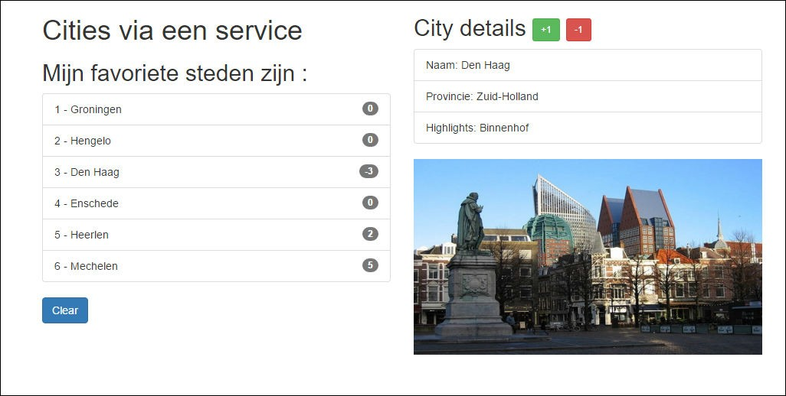
Resultaat

Slide 28
Samenvatting
Parent → Child
Child → Parent
<app>
<app>
[city]=“someCity”
(rate)=“onRate()”
<city-list>
<city-list>
[city]=“someCity”
(rate)=“onRate()”
<city-detail>
<city-detail>

Slide 29
Checkpoint
Data flow naar Parent Component : werken met @Output() en
(eventName)=“eventHandler($event)”
Je kunt allerlei typen Events meegeven
Opdracht 6d
Oefening….

Slide 30












Communicatie tussen sibl
ings
nent, naar een @Inp
via Output() van een childcompo andere childcompon
< >
ut() van
ent
parent
Handle someEvent, set someProperty
[someProperty]=“someProperty”
meEvent)=“someE
(so
vent()”
<child-
1>
<child-2>
emo: 12a-components-siblin
T-IT
D
gs
5HAR

Slide 31
Mooiere oplossing – Pub/Sub-systeem met Observables
“Custom events, gebruik een event bus”

Slide 32
Event bus
Event
App
<component-1>
<component-4>
<component-2>
<component-3>
<component-5>
{{…}
}
{{…}
}
{{…}
}

Slide 33
Opties
Uit RxJs-bibliotheek, werken met:
EventEmitter()
Observable()
Observer()
Subject() (zowel Observable als Observer)
“Publish en Subscribe” – PubSub systeem

Slide 34
<city-list>
<city-details>
Boek nu!
publish
Event
<city-orders>
subscribe

Slide 35
PubSub-service maken
Stap 1 – Publicatie service maken
Stap 2 – ‘Producer’, of ‘Publish’ – component maken
Stap 3 – subscriber-component maken, of toevoegen aan bestaande component.

Slide 36
1. OrderService
// order.service.ts
import {Subject} from "rxjs/Subject"; import {Injectable} from "@angular/core"; import {City} from "../model/city.model";
@Injectable()
export class OrderService { stream:Subject<City>;
constructor() {
this.stream = new Subject<City>();
}
}

Slide 37
2. Producer component (‘boek nu’-knop)
In de HTML:
<h2>Prijs voor een weekendje weg:
{{ city.price | currency:'EUR':true:'1.2' }}
<button class="btn btn‐lg btn‐info" (click)="order(city)">Boek nu!</button>
</h2>
In de class:
// Order plaatsen. Event emitten voor deze stad.
// Dit gaan opvangen in city.orders.ts
order(city) {
console.log(`Stedentripje geboekt voor: ${this.city.name}); this.orderService.stream.next(city);
}

Slide 38
3. Subscriber component
//city.orders.ts ‐ Een soort 'winkelmandje',
// bijhouden welke stedentripjes zijn geboekt.
import …
@Component({
selector: 'city‐orders', template: `
<div *ngIf="currentOrders.length > 0">
…
})
export class CityOrdersComponent {
…
ngOnInit() {
this.orderService.stream
.subscribe(
(city:City) => this.processOrder(city), (err)=>console.log('Error bij verwerken City‐order'), ()=>console.log('Complete...')
)
}
` …
}

